Slide 1

heaps
“The Ténéré Tree that was once considered the most isolated tree on Earth—the only one for over 400 kilometres (250 mi). It was a landmark on caravan routes through the Ténéré region of the Sahara Desert in northeast Niger, so well known that it and the Arbre Perdu or 'Lost Tree' to the north are the only trees to be shown on a map at a scale of 1:4,000,000. The Tree of Ténéré was located near a 40-metre (131 feet)-deep well. It was knocked down in 1973, by a drunk truck driver.”
https://en.wikipedia.org/wiki/Tree_of_T%C3%A9n%C3%A9r%C3%A9
By Michel Mazeau - https://commons.wikimedia.org/w/index.php?curid=4240288

Slide 2
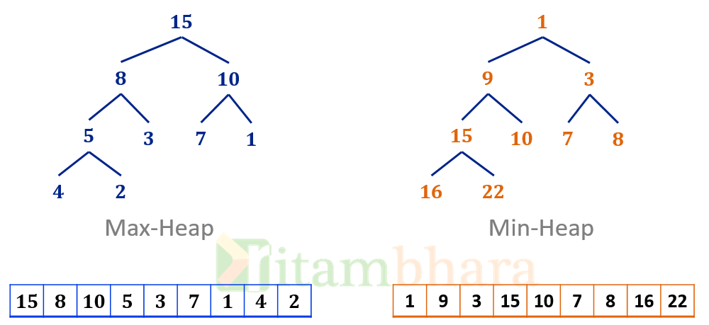
heaps – THERE’s TWO KINDS
Max Heap & Min Heap
(implemented as binary tree)

Slide 3

min-heap
“The Rainbow Eucalyptus is found mostly in the Pacific Islands (the one in this picture is from Kauai). The strange coloration happens with the surface layer of bark falls off. The bark underneath starts off brown and then changes colors over time, giving the tree its rainbow effect.”
https://matadornetwork.com/trips/21-beautiful-trees-forests/

Slide 4
heaps: MIN-HEAP
A min-heap is a binary tree where each node’s value is smaller than that in either child. This is called the min-heap property.
A min-heap’s root must have the minimum (smallest) value.

Slide 5
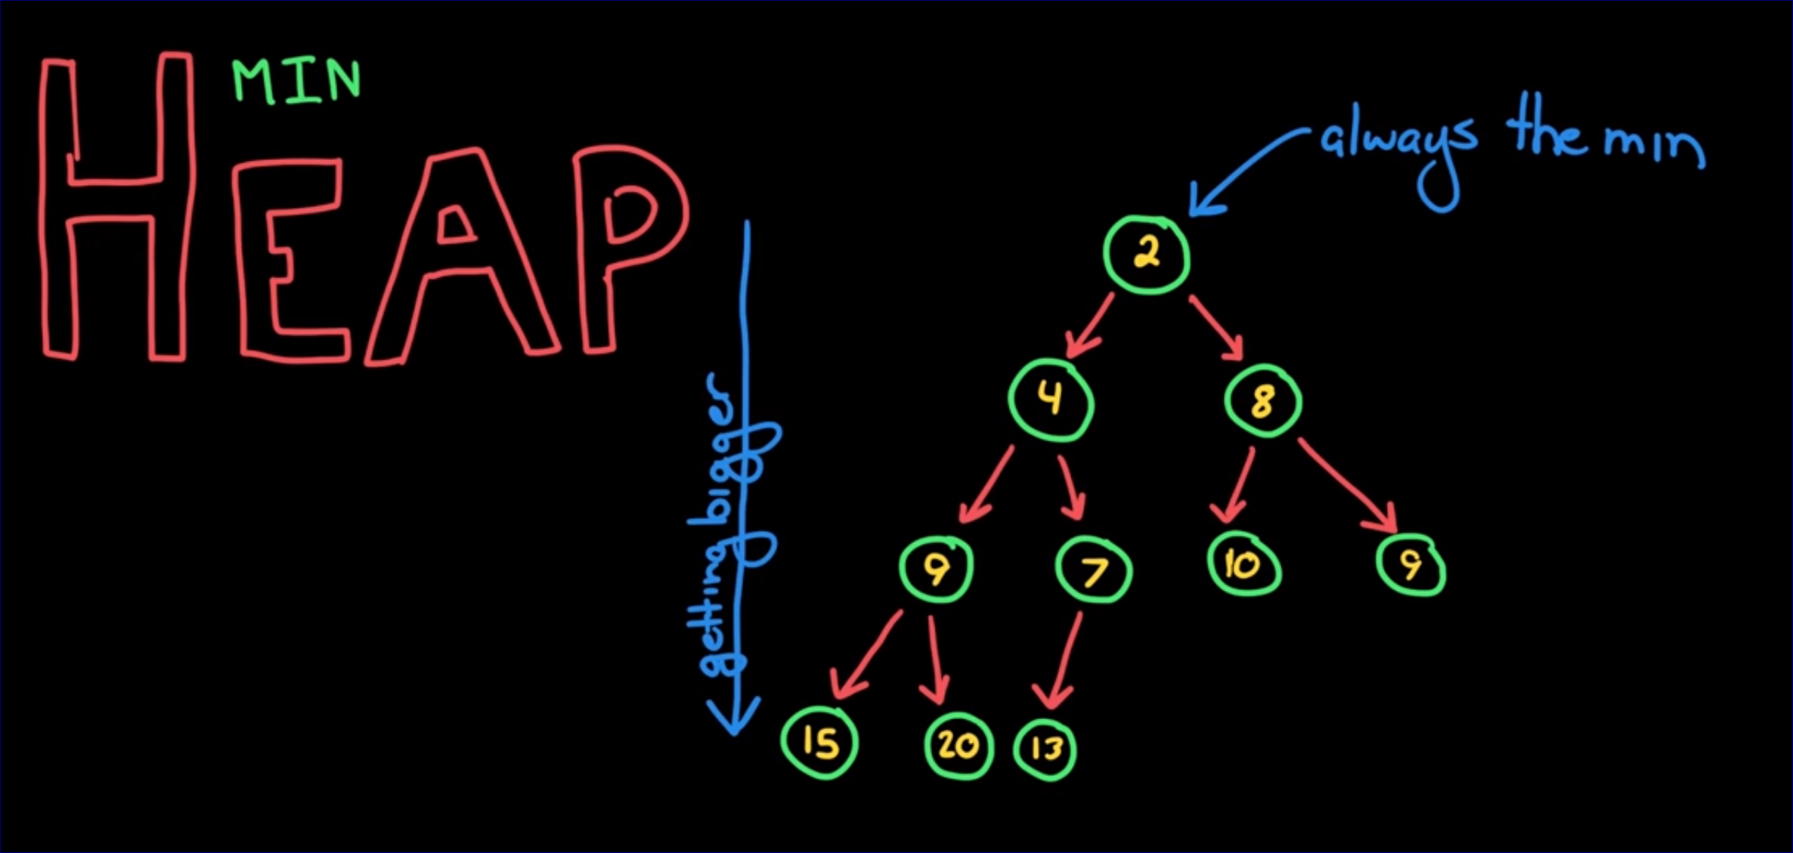
HEAPS: MIN-HEAP

Slide 6
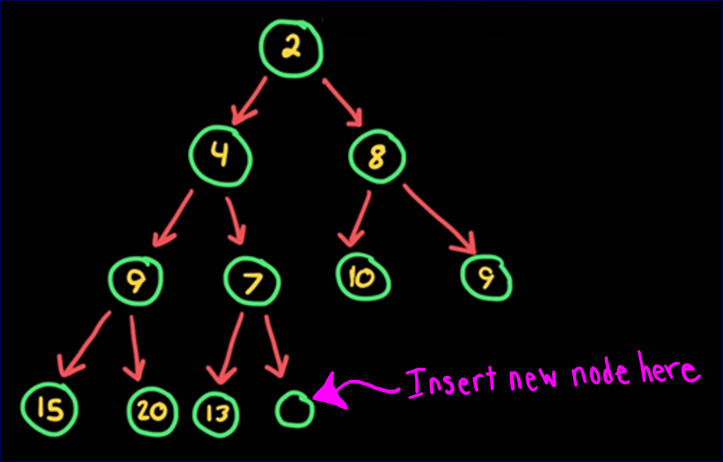
MIN-heap operations - insert
insert step one
Insert node in the tree’s
next empty spot –
looking top to bottom
and then left to right

Slide 7
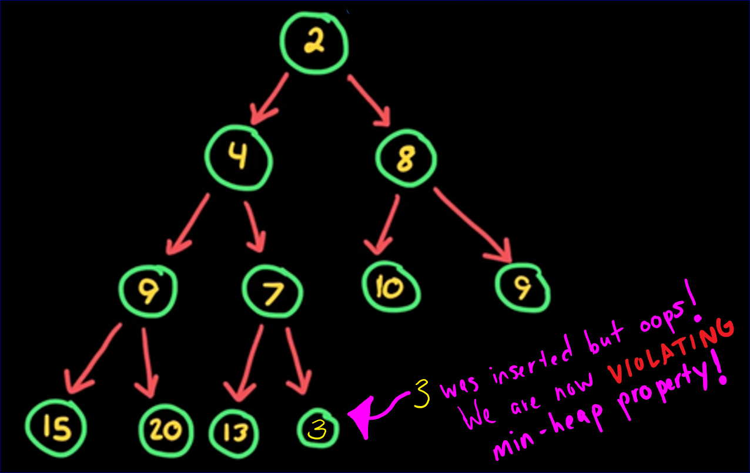
MIN-heap operations - insert

Slide 8
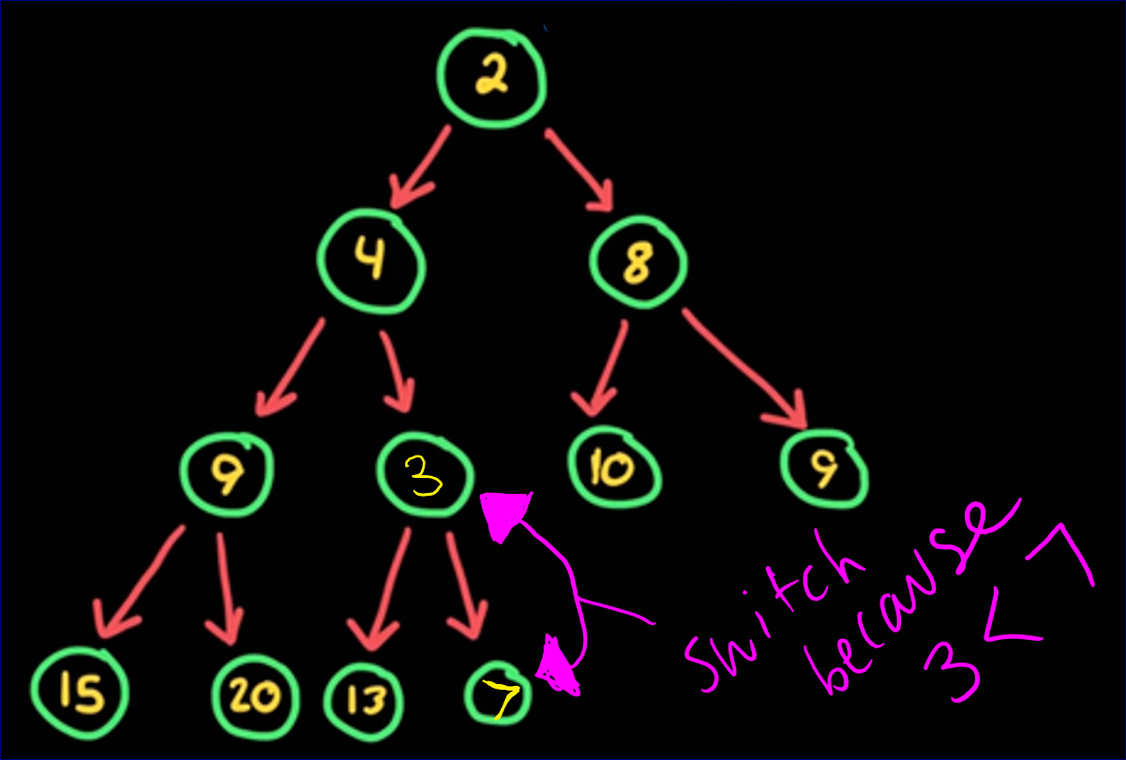
MIN-heap operations - insert
insert step two
Swap the node with
its parent until it is in
its right spot (no
min-heap property
violation occurs)

Slide 9
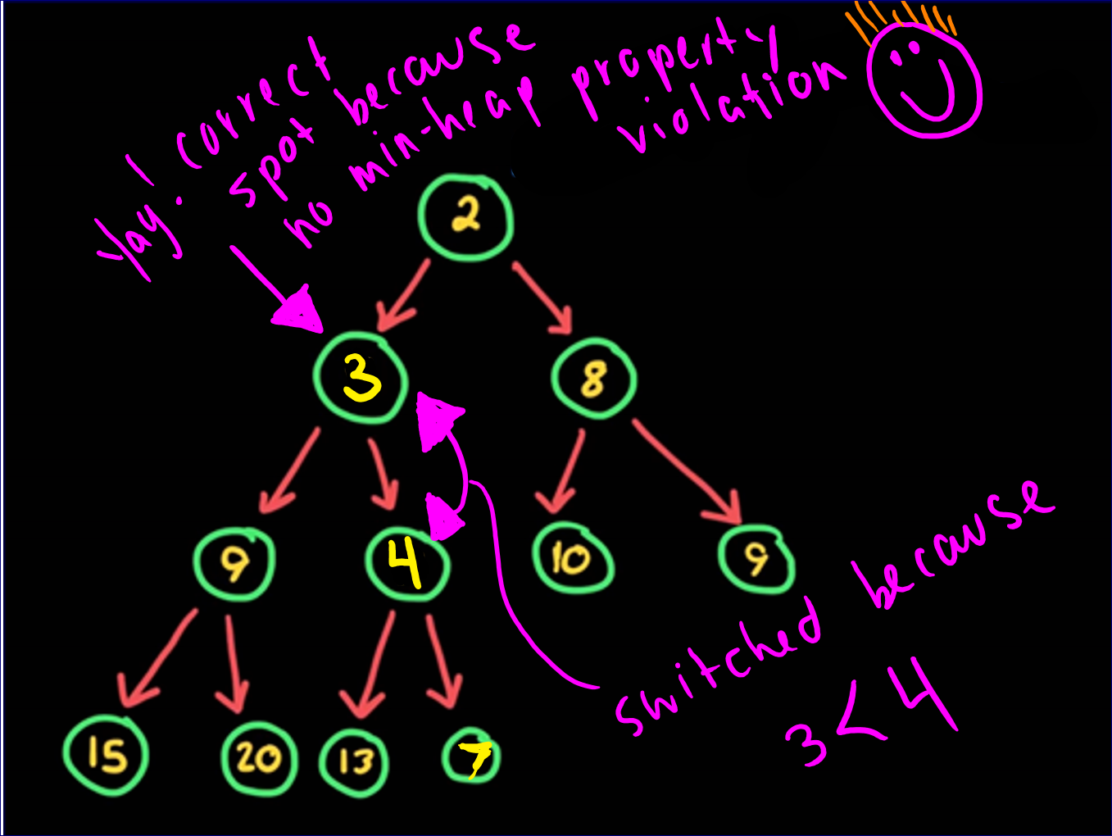
MIN-heap operations - insert
insert step two
KEEP GOING…

Slide 10
MIN-heap operations - insert
insert step two
The moving up (by swapping parent & child) is sometimes called one of the following:
bubble up
percolating
sift-up

Slide 11
heap operations - Remove
remove
A heap is an implementation of a priority queue.
The root is the top priority (in a min-heap it is the lowest value).
Remember in a queue (FIFO) you remove by calling the dequeue or pop function, which removes the front or first node. So for a binary tree, you would remove the ROOT node.

Slide 12
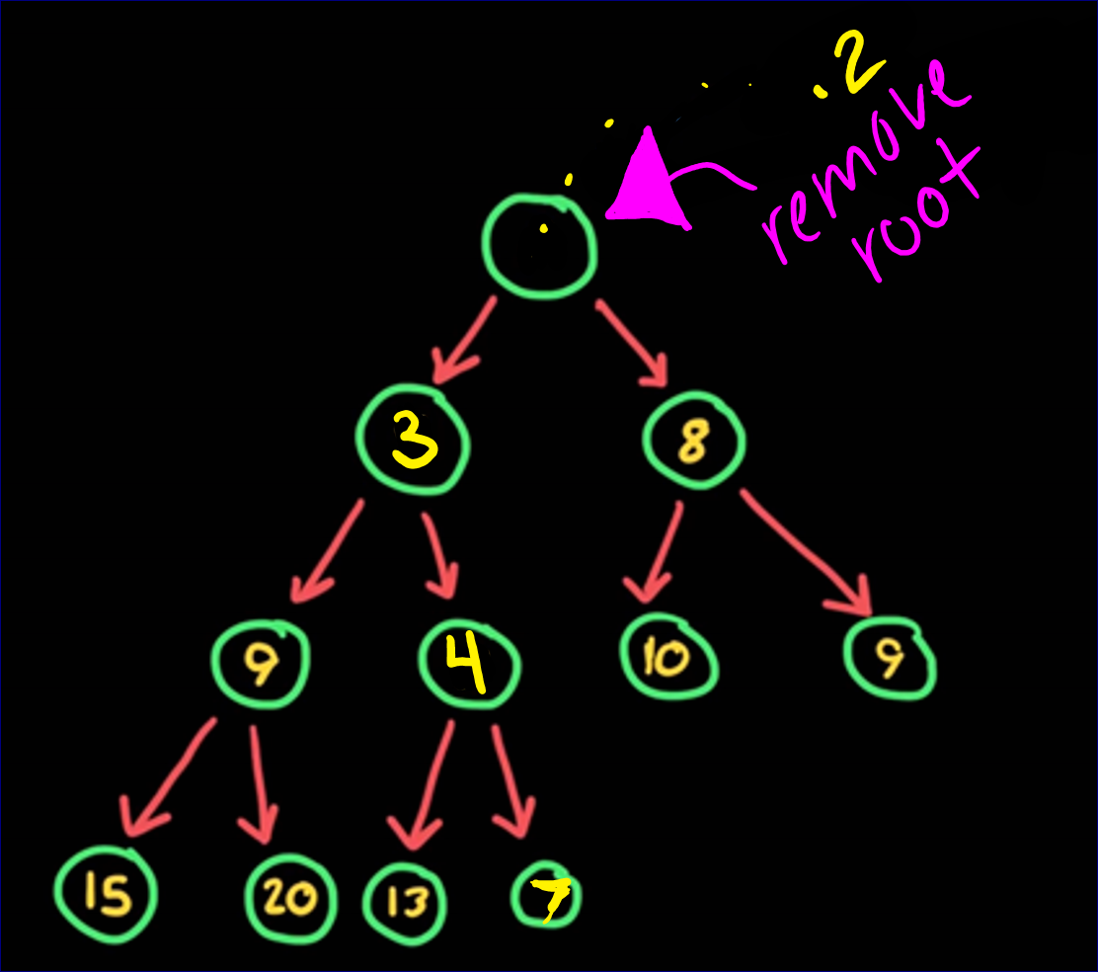
heap operations - Remove
remove step one
Remove the root

Slide 13
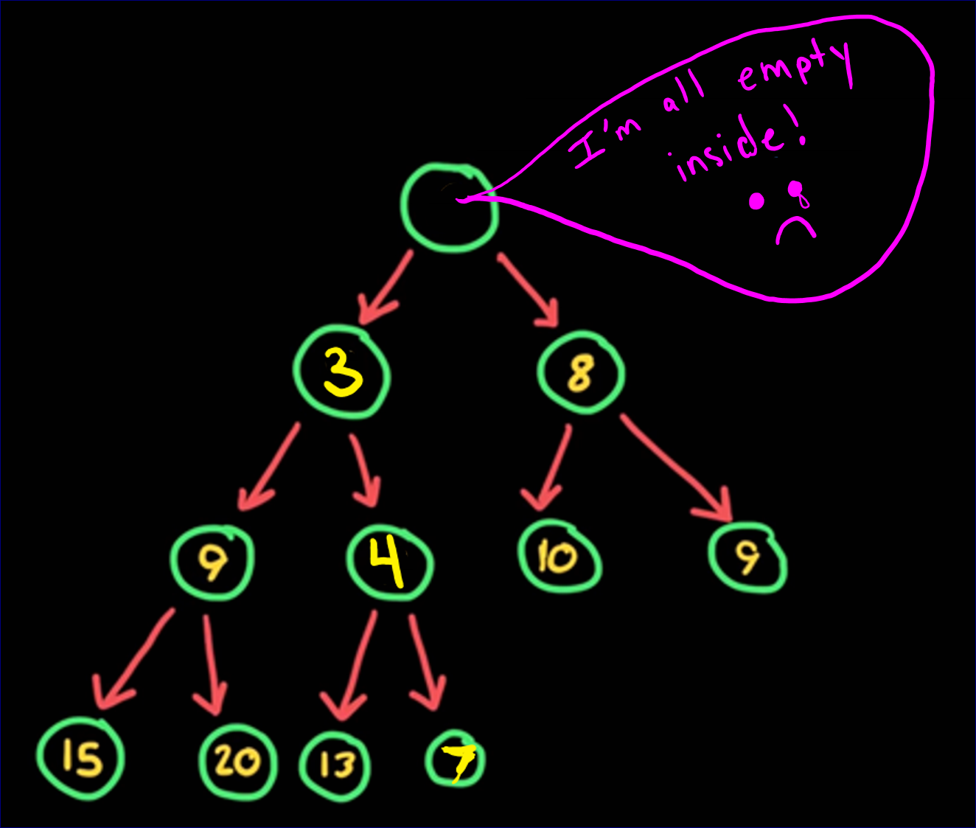
heap operations - Remove
remove step one
Uh-oh! There’s no root!

Slide 14
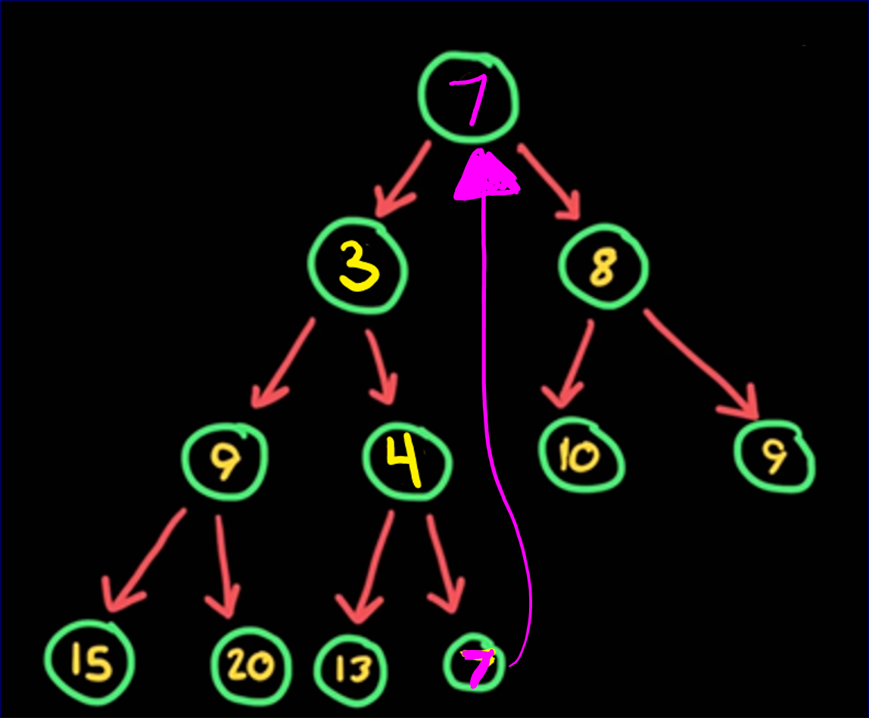
heap operations - Remove
remove step two
Make the last level’s last
node the new root

Slide 15
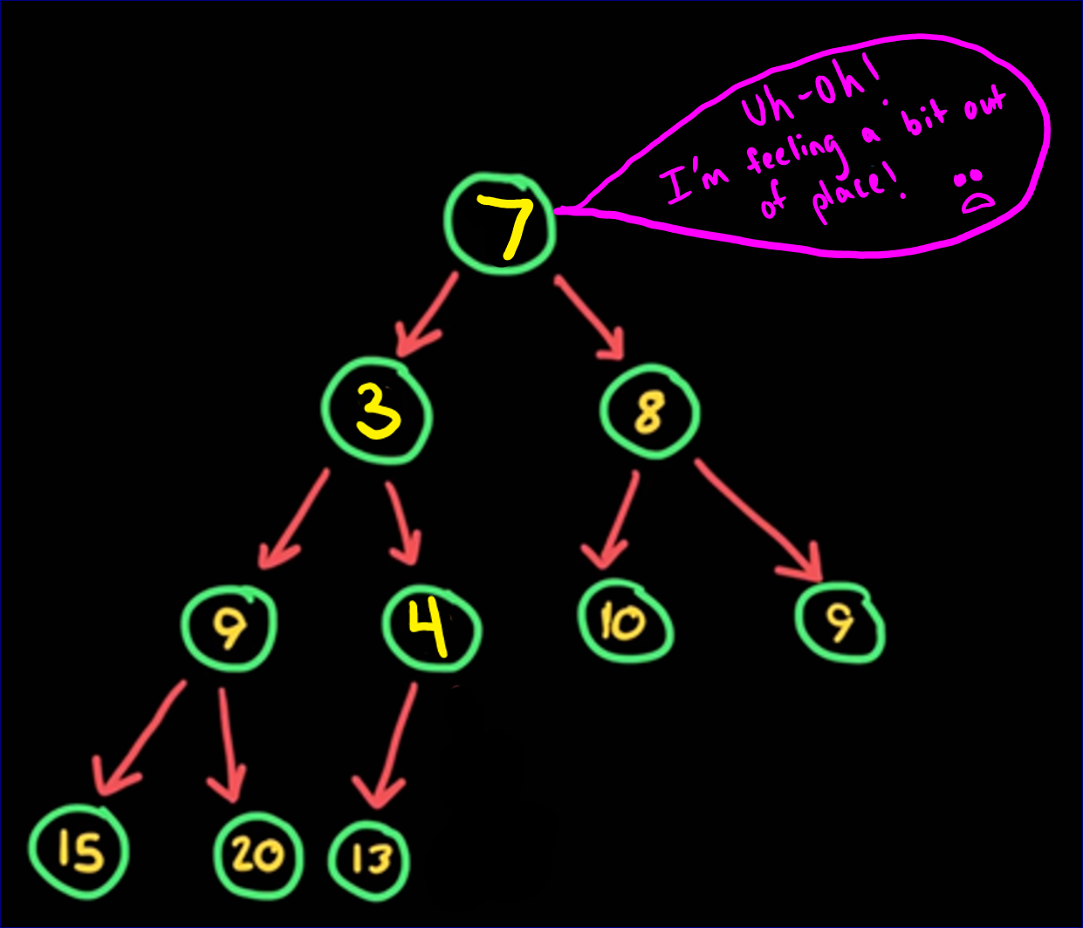
heap operations - Remove
remove step two
…now we have a min-heap
property violation.

Slide 16
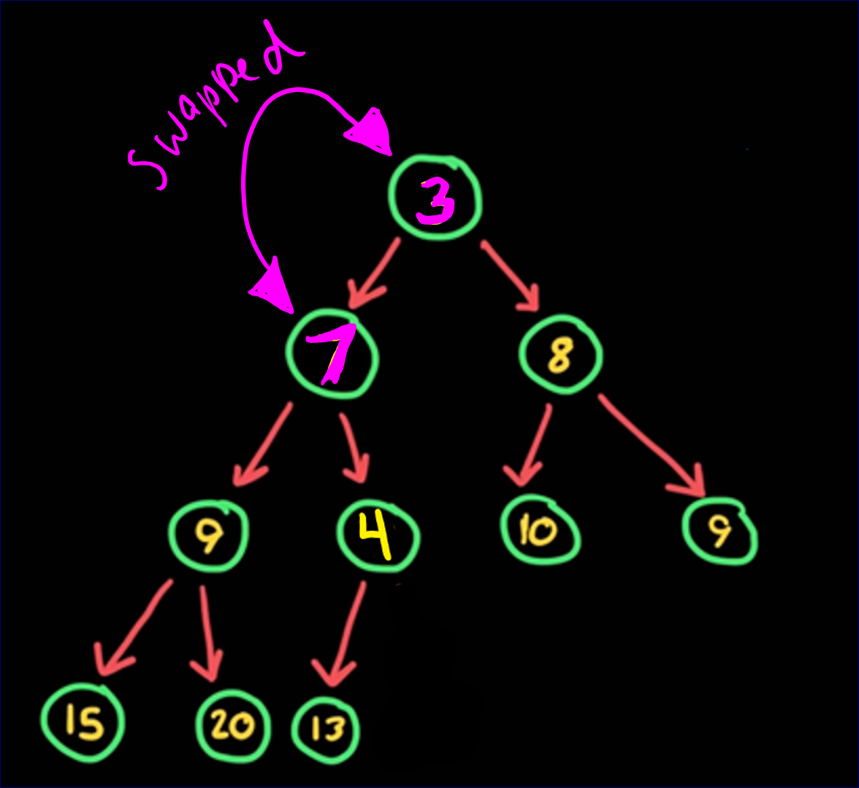
heap operations - Remove
remove step three
Fix the violation by swapping
the node with it’s child until
there is no longer a violation.
(commonly called sift-down,
bubble-down, etc.)

Slide 17
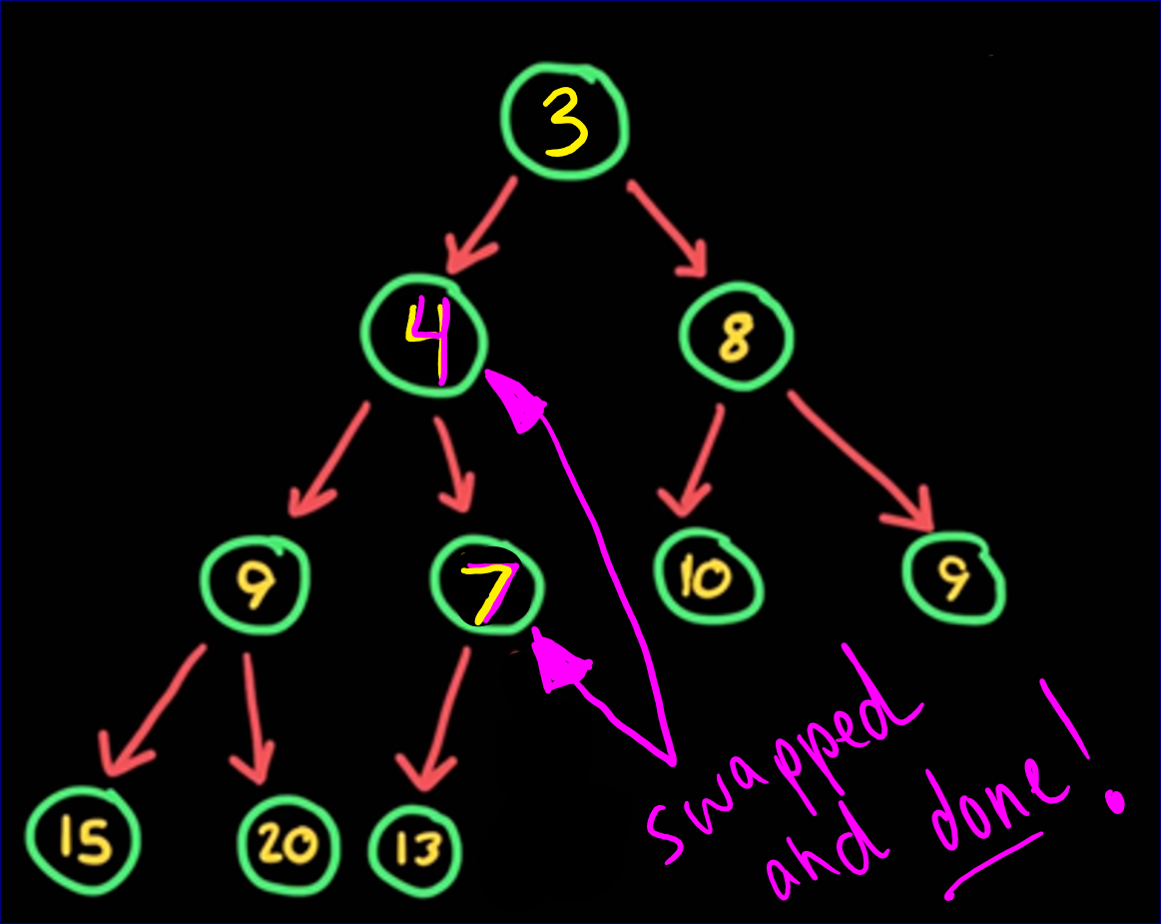
heap operations - Remove
remove step three
Fix the violation by swapping
the node with it’s child until
there is no longer a violation.

Slide 18
Time Complexity of Insert/REMOVE in Heap
The (worst-case) time complexity of inserting and removing into a heap is based on the number of swaps that will have to happen in order to maintain the heap property.
The number of swaps is the same order as the height of the binary tree.
The height is O(log₂N), so the maximum number of swaps is O(log₂N)

Slide 19
heap operations (all the other ones)
isEmpty() – sees whether the heap is empty, returns boolean
getNumberofNodes() – gets the number of nodes in the heap
getHeight() – get the height of the heap
peek() – returns the root value (minimum value for min-heap)
clear() – removes all nodes from the heap

Slide 20
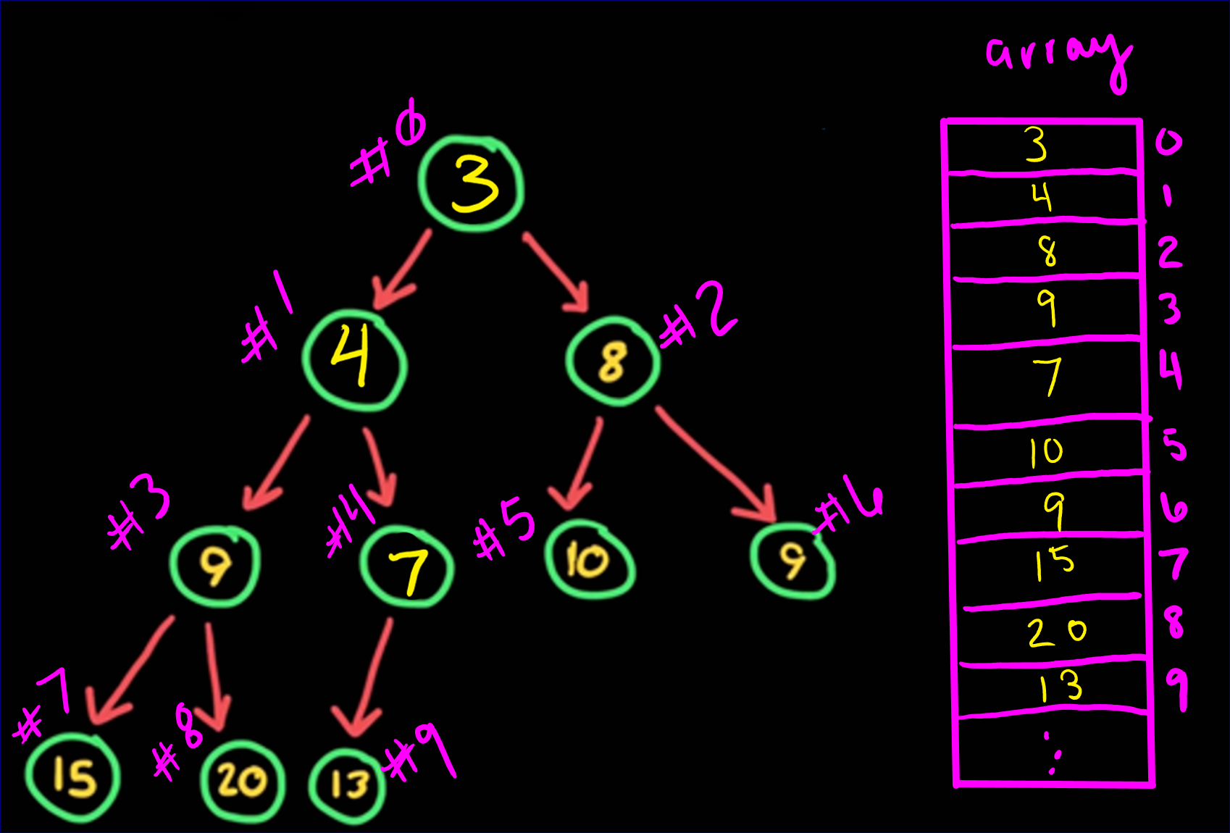
Heap implementation - ARRAY
Because the insert & remove operations are like a queue, we can actually use an array to implement a heap instead of a linked list.

Slide 21
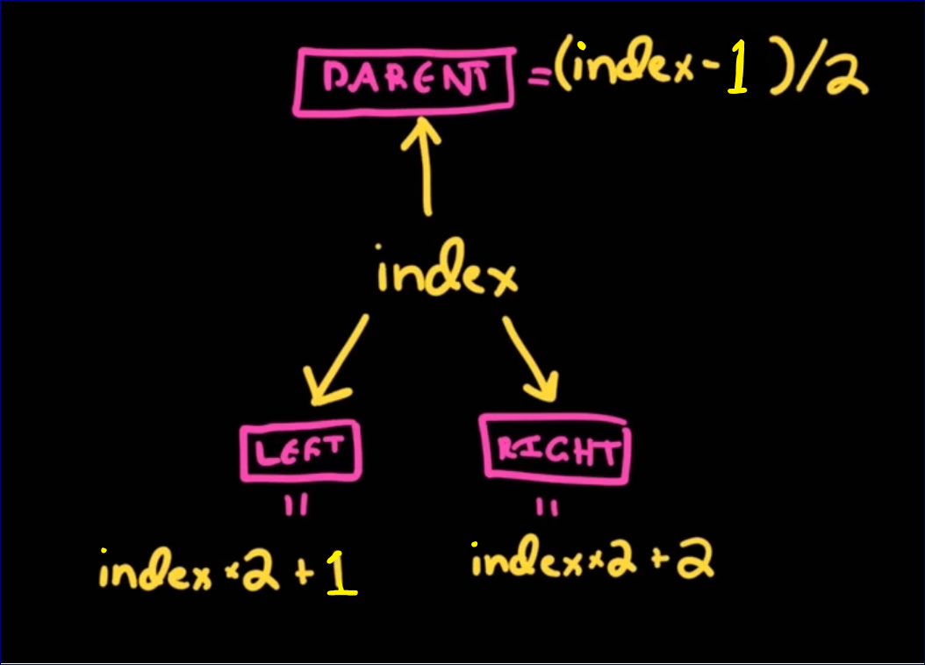
Heap implementation - ARRAY
A simple equation can map from an INDEX to it’s left child, right child, or parent!

Slide 22
Heap implementation - ARRAY
PARENT of NODE with INDEX 2 (value of 8)?
Index of Parent = FLOOR((INDEX–1)/2) =
FLOOR((2-1)/2) = INDEX 0
LEFT CHILD of NODE with INDEX 2 (value of 8)?
Index of Left Child = INDEX*2+1 = 2*2+1 = INDEX 5
RIGHT CHILD of NODE with INDEX 2 (value of 8)?
Index of Right Child = INDEX*2+2 = 2*2+2= INDEX 6

Slide 23

max-heap
This Bamboo Forrest is “technically not a tree (it’s a grass)”. This is Sangano Bamboo Forest near Kyoto, Japan.
https://matadornetwork.com/trips/21-beautiful-trees-forests/

Slide 24
heaps: Max-Heap
A max-heap (most common) is a binary tree where each node’s value is larger than that in either child. This is called the max-heap property.
A max-heap’s root must have the maximum (largest) value.

Slide 25
minheap example
ArrayMinHeap folder
ArrayMinHeap.h
DriverForMinHeap.cpp

Slide 26
heaps: Max-Heap
Everything is the same for a Max Heap as the Min Heap except for following the max-heap property instead of min-heap property.
Implementation is very similar
ArrayMaxHeap.h
DriverForMaxHeap.cpp

Slide 27
HEIGHT of HEAP (or binary tree)
ceil(log₂N+1)-1
Hey, why can’t it just be floor(log₂N+1)?

Slide 28
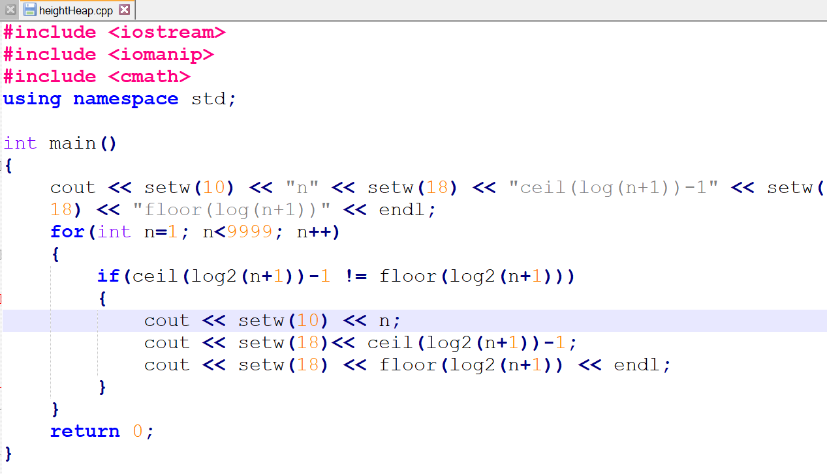
HEIGHT of HEAP (or a complete binary tree)
Ceil(log(n+1))-1 is not equal to floor(log(n+1)) for all values of n.
Proof: I wrote a program! (heightHeap.cpp)

Slide 29
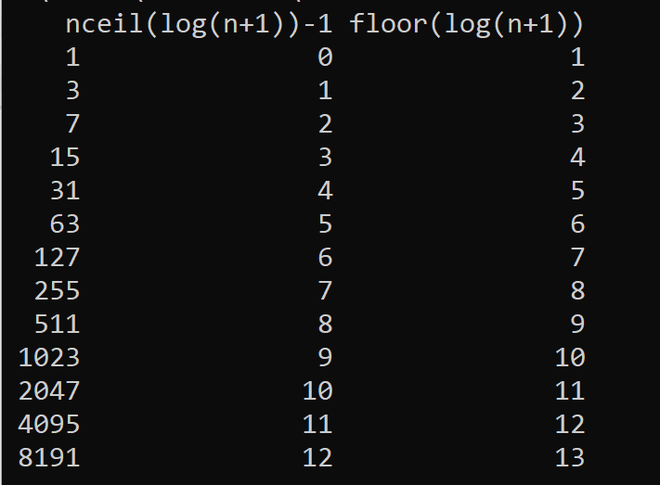
HEIGHT of HEAP (or a complete binary tree)
Output of heightHeap.cpp:

Slide 30
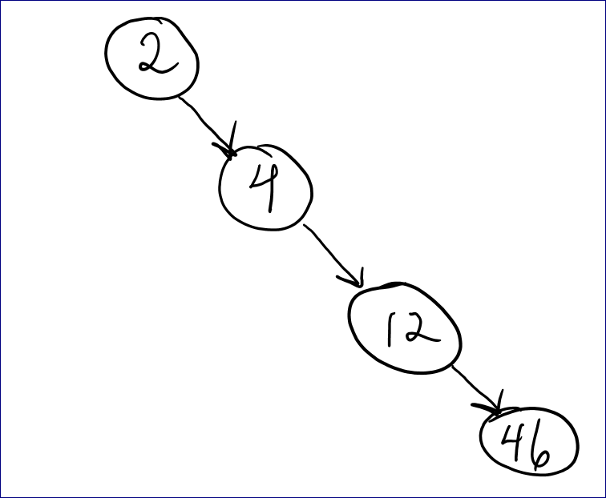
efficiency – Big O Notation
A HEAP is a balanced tree and so it eliminates this problem: So, a HEAP is O (log₂N)

Slide 31

END of HEAP

